Slide 1
Python Full Course

Slide 2
Python Introduction
Python is an interpreted object-oriented scripting language functional oriented high-level programming language with dynamic semantics. built in data structures dynamic typing and dynamic binding

Slide 3
Development Steps of Python
Guido Van Rossum ---- first version of Python code (version 0.9.0) ---February 20th 1991 ---- exception handling, functions, and the core data types of list, dict, str and others. It was also object oriented and had a module system.
Python version 1.0 --- January 1994. --- functional programming tools lambda, map, filter and reduce.
Python 2.0 ---- October 2000 --- list comprehensions, a full garbage collector and it was supporting Unicode.
as Python 3.0 (also known as "Python 3000" and "Py3K") – 2008-- Python 3 is not backwards compatible with Python 2.x. Some changes in Python 3.0:

Slide 4
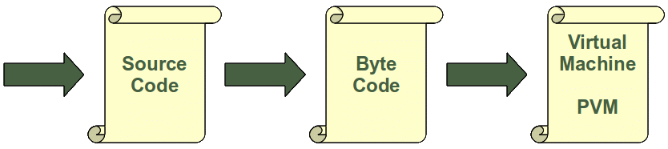
Python Interpreter

Slide 5
Interpreter Vs Compiler
Interpreter | Compiler
Translates program one statement at a time. | Scans the entire program and translates it as a whole into machine code.
It takes less amount of time to analyze the source code but the overall execution time is slower. | It takes large amount of time to analyze the source code but the overall execution time is comparatively faster.
No intermediate object code is generated, hence are memory efficient. | Generates intermediate object code which further requires linking, hence requires more memory.
Continues translating the program until the first error is met, in which case it stops. Hence debugging is easy. | It generates the error message only after scanning the whole program. Hence debugging is comparatively hard.
Programming language like Python, Ruby use interpreters. | Programming language like C, C++ use compilers.

Slide 6
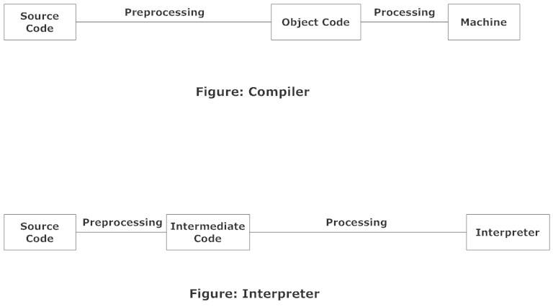
Interpreter Vs Compiler

Slide 7
Scripting and Programming Languages
all scripting languages are programming languages. The theoretical difference between the two is that scripting languages do not require the compilation step and are rather interpreted.,
a scripting language like JavaScript or PHP need not be compiled.
compiled programs run faster than interpreted programs because they are first converted native machine code. Also, compilers read and analyze the code only once, and report the errors collectively that the code might have, but the interpreter will read and analyze the code statements each time it meets them and halts at that very instance if there is some error.
Some programming languages traditionally used with an explicit compilation step are C, C++.

Slide 8
Types of scripting languages
Perl (Practical Extraction and Report Language). This is a popular string processing language for writing small scripts for system administrators and web site maintainers. Much web development is now done using Perl.
Hypertalk is another example. It is the underlying scripting language of HyperCard.
Lingo is the scripting language of Macromedia Director, an authoring system for develop high-performance multimedia content and applications for CDs, DVDs and the Internet.
AppleScript, a scripting language for the Macintosh allows the user to send commands to the operating system to, for example open applications, carry out complex data operations.
JavaScript, perhaps the most publicished and well-known scripting language was initially developed by Netscape as LiveScript to allow more functionality and enhancement to web page authoring that raw HTML could not accommodate. A standard version of JavaScript was later developed to work in both Netscape and Microsoft's Internet Explorer, thus making the language to a large extent, universal. This means that JavaScript code can run on any platform that has a JavaScript interpreter.
VBScript, a cut-down version of Visual Basic, used to enhance the features of web pages in Internet Explorer.

Slide 9
Top 10 Reasons To Learn Python
Python’s popularity & high salary
Python is used in Data Science -- Matrix as well as statistical data(Matplotlib and Seaborn) and Python numerical engines ( Numpy, Scipy and Pandas )
Python’s scripting & automation
Python used with Big Data – Pydoop , Data Proccesing(Dask,pyspark)
Python supports Testing – Pytest , Robot
Computer Graphics in Python – Tkinter , Pygame
Python used in Artificial Intelligence – Keras , TensorFlow , OpenCv
Python in Web Development – Django , Flask, Pylons ,e.t.c.
Python is portable & extensible
Python is simple & easy to learn

Slide 10
Various Languages involved in Python Development
Functional Programming --- C language
OOPS --- C++
Scripting programming --- Perl and Shell Script
Modular Programming --- Modula-3

Slide 11
Flavours of Python
Jython or Jpython – Java
IronPyhton – Dotnet
Pypy – PVM(JIT)
RubyPython – Ruby
Anaconda Python – Bigdata
Stackless Python – Concurrency

Slide 12
print (value1, ..., sep=' ', end='\n', file=sys.stdout, flush=False)
Print Function
objects - object to the printed. * indicates that there may be more than one object
sep - objects are separated by sep. Default value: ' '
end - end is printed at last
file - must be an object with write(string) method. If omitted it, sys.stdout will be used which prints objects on the screen.
flush - If True, the stream is forcibly flushed. Default value: False
Print is a function in python 3.x version and it is a statement in 2.x version

Slide 13
Python shell act as calculator
We can do mathematical calculation by using python shell directly.
For example
>>> a =10 ,b=5
>>> c = a+b -- Addition
>>> c = a-b -- Subtraction
>>> c = a * b -- Multiplication
>>> c = a / b -- Division
>>> c = a % b -- Modulus ( a-((a//b)*b)
>>> c = a**b -- Exponent i.e. pow(a , b)
>>> c = a // b -- Floor Division

Slide 14
Lines and Indentation
Python does not use braces ({}) to indicate blocks of code for class and function definitions or flow control.
Blocks of code are denoted by line indentation, which is rigidly enforced. The number of spaces in the indentation is variable, but all statements within the block must be indented the same amount. For example-
If True:
Print (“True”)
else:
print (“False”)

Slide 15
Multi-Line Statements
Statements in Python typically end with a new line. Python, however, allows the use of the line continuation character (\) to denote that the line should continue. For example
total = item_one +\
item_two + \
item_three
The statements contained within the [], {}, or () brackets do not need to use the line continuation character. For example
days = ['Monday', 'Tuesday', 'Wednesday', 'Thursday', 'Friday']

Slide 16
Quotation in Python
Python accepts single ('), double (") and triple (''' or """) quotes to denote string literals , as long as the same type of quote starts and ends the string.
The triple quotes are used to span the string across multiple lines. For example, all the following are legalword = 'word' sentence = "This is a sentence." Paragraph = """This is a paragraph. It is made up of multiple lines and sentences."""

Slide 17
Comments in Python
A hash sign (#) that is not inside a string literal is the beginning of a comment. All characters after the #, up to the end of the physical line, are part of the comment and the Python interpreter ignores them.
A statement between triple quotations (‘’’ ‘’’ and “”” “”””) called as multiline comment. For example
‘’’ this is a
Multiline comment’’’
“””This is also
multiline
comment”””

Slide 18
Multiple Statements on a Single Line
The semicolon ( ; ) allows multiple statements on a single line given that no statement starts a new code block.
Here is a sample snip using the semicolon import sys; x = 'foo'; sys.stdout.write(x + '\n').

Slide 19
Multiple Assignment
Python allows you to assign a single value to several variables simultaneously. For example a = b = c = 1 Here, an integer object is created with the value 1, and all the three variables are assigned to the same memory location.
You can also assign multiple objects to multiple variables.
For example a, b, c = 1, 2, "john" Here, two integer objects with values 1 and 2 are assigned to the variables a and b respectively, and one string object with the value "john" is assigned to the variable c.

Slide 20
Python Identifiers
A Python identifier is a name used to identify a variable, function, class, module or other object.
An identifier starts with a letter A to Z or a to z or an underscore (_) followed by zero or more letters, underscores and digits (0 to 9).
Python does not allow punctuation characters such as @, $, and % within identifiers.
Python is a case sensitive programming language. Thus, Manpower and manpower are two different identifiers in Python.
Don’t use inbuilt python keywords as python identifiers.

Slide 21
Naming conventions for Python identifiers
Class names start with an uppercase letter. All other identifiers start with a lowercase letter.
• Starting an identifier with a single leading underscore indicates that the identifier is protected.
• Starting an identifier with two leading underscores indicates a strong private identifier. • If the identifier also ends with two trailing underscores, the identifier is a language defined special name.

Slide 22
Reserved Words
The following list shows the Python keywords. These are total 33 reserved words and you cannot use them as constants or variables or any other identifier names. All the Python keywords contain lowercase letters only, except 3 keywords .i.e. None, True, False
and exec except as finally or assert for pass break from print class global raise continue if return def import try del in while elif is with else lambda yield
None True False
You can check this Reserved words as below
>>> import keyword
>>> print (keyword.kwlist)

Slide 23
Getting Input from the User(input vs raw_input)
Python 2 has two versions of input functions, input() and raw_input().
The input() function treats the received data as string if it is included in quotes '' or "", otherwise the data is treated as number.
In Python 3, raw_input() function is deprecated. Further, the received data is always treated as string.

Slide 24
In Python 2
>>> x=input('something:') something:10 #entered data is treated as number.
>>> x=input('something:') something:'10' #entered data is treated as string.
x=raw_input("something:") something:10 #entered data is treated as string even without '‘.
x=raw_input("something:") something:'10' #entered data treated as string including ''

Slide 25
In Python 3
>>> x=input("something:") something:'10' #entered data treated as string with or without '‘.
x=raw_input("something:") # will result NameError Traceback (most recent call last): File "", line 1, in x=raw_input("something:") NameError: name 'raw_input' is not defined

Slide 26
range () and xrange() function
In Python 2 range() returns a list, and xrange() returns an object that will only generate the items in the range when needed, saving memory.
In Python 3, the range() function is removed, and xrange() has been renamed as range().
In addition, the range() object supports slicing in Python 3.2 and later versions.

Slide 27
In Python 2
x=range(10)
>>> type(x)
<type 'list'>
>>> x=xrange(10)
>>> type(x)
<type 'xrange'>
In Python 3
>>> x=range(10)
>>> type(x)
<class 'range'>
>>> x=xrange(10)
Traceback (most recent call last):
File "<pyshell#2>", line 1, in <module>
x=xrange(10)
NameError: name 'xrange' is not defined

Slide 28
Python’s range() function parameters
The range() function has two set of parameters , as follows:
→ range(stop)
-- stop: Number of integers (whole numbers) to generate , starting from zero. E.g. range(5) == [0,1,2,3,4]
→ range([start],stop [,step])
-- start: Starting number of the sequence.
-- stop: Generate numbers up to ,but not include this number.
-- step: Difference between the each number in the sequence.
Notes:
<number>

Slide 29
→Note that :
All parameters must be integers.
All parameters can be positive or negative.
range() is 0 – index based ,means list index's start at 0 , not 1.
The syntax access the first element of a list is mylist[0]. Therefore the
last integer generated by range() is up to ,but not including stop.

